Slide 1

Telecom Churn customers

Slide 2
Team members
Salma sameh Mahmoud
Habiba anwar shafie
Mohamed ahmed abdellah
Ibrahim elmetwally Abdelhamid
Mohamed Samir

Slide 3

Project idea
Churn customers prediction

Slide 4

Description
Our model trained on customer churn dataset for a telecommunications company and then predict which customers are likely to leave the service based on demographic and service-related features.

Slide 5
Business impact
Reducing customer churn can improve revenue and optimize marketing efforts

Slide 6
About dataset
Overview : The dataset contains 7,043 customer records with 21 features, including customer demographics ,service-related data and churn status.
Churn rate :The churn rate is 26.5%, with 5,163 customers not churning and 1,869 customers churning.
Accuracy :The highest accuracy achieved on this dataset is 86.7%

Slide 7
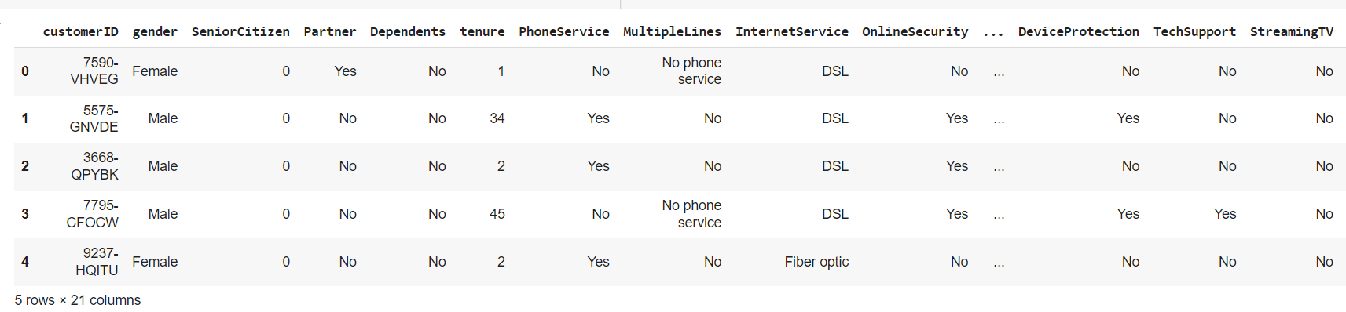
Features

Slide 8
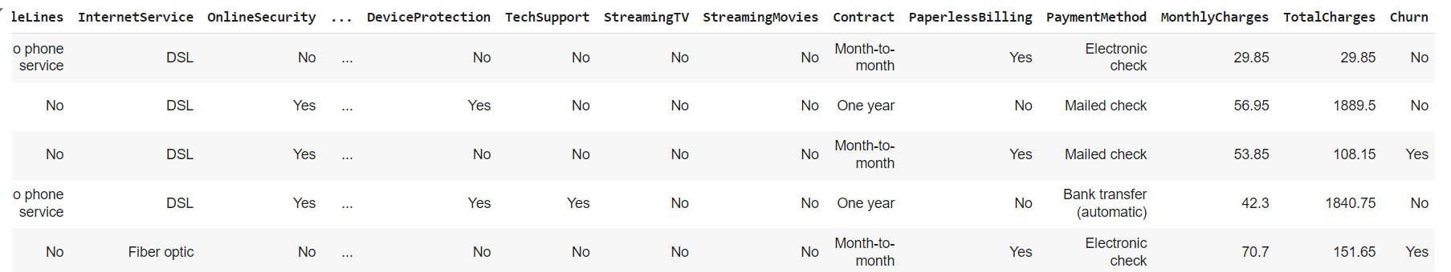
Features

Slide 9
Exploratory Data Analysis (EDA)
Do basic statistics analysis to get more insights and information about the dataset like data types , duplicates , and missing values .
Check distribution of important features like churn , and the relation between it and other features and visualize the results

Slide 10
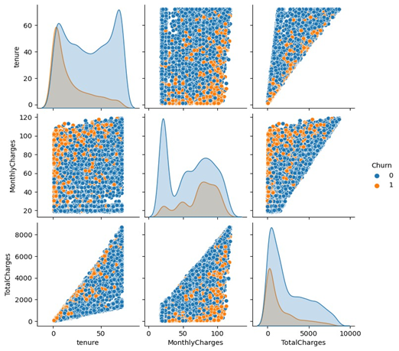
Relation ship between numeric features and churn

Slide 11
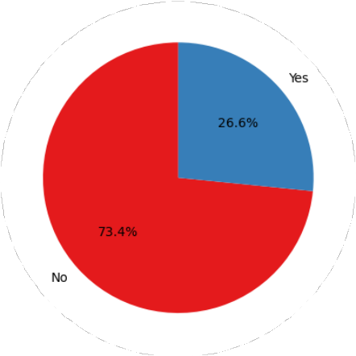
Churn distribution

Slide 12
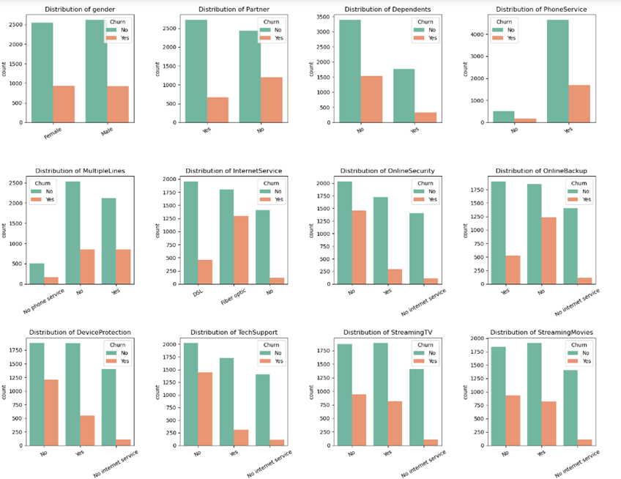
Relation ship between categorical features
Gender: Similar churn rates for both genders
Partner: Higher churn without partners.
Dependents: More churn without dependents.
Phone Service: Higher churn for those without phone service.
Internet Service: Fiber optic users churn more than DSL users.
Contract: Month-to-month contracts have the highest churn.
Payment Method: Electronic check users churn more.
Senior Citizens: Higher churn for senior citizens

Slide 13
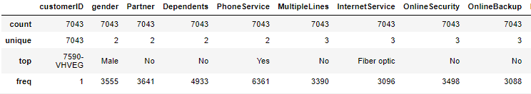
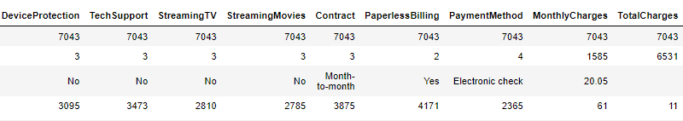
Descriptive statistics for categorical variables

Slide 14
Feature engineering
Created 'TenureGroup' to categorize tenure into groups
Combined 'Contract' and 'PaymentMethod' into a new feature 'Contract_PaymentInteraction
Derived 'ChargesPerMonth' from TotalCharges and tenure
Added ‘HasPhoneAndInternet’ to indicate customers with both services
Calculated 'NumServices' to represent the total number of services per customer

Slide 15

Insights on churn for customers with internet services
The majority of customers have both phone and internet services .
Customers without both services have a lower churn rate.
Among those with both services , churn is higher, though most still remain loyal .

Slide 16
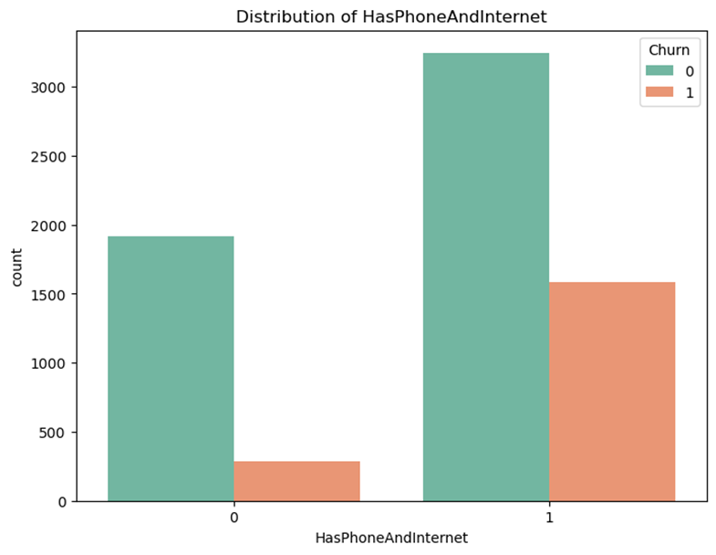
Distribution of has phone and internet feature

Slide 17
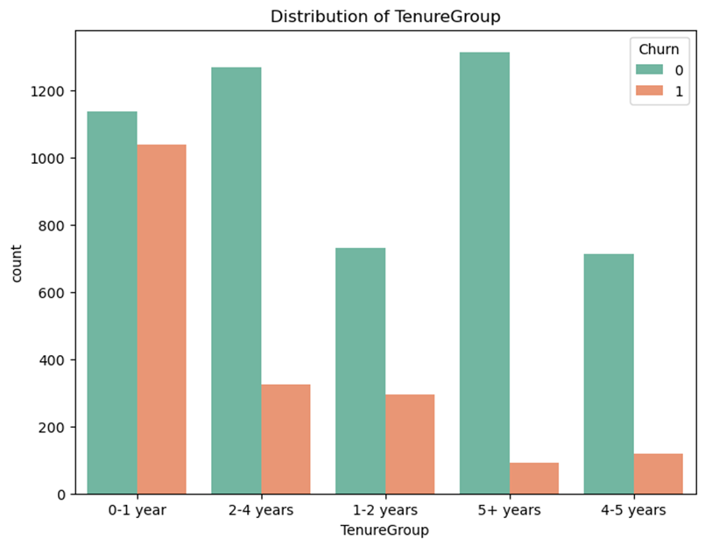
Insights on churn based on tenure group
Customers in the 0 - 1 year group show a much higher churn rate compared to other tenure groups .
As tenure increases , churn significantly
decreases , with the 5 + years group having the lowest churn rate

Slide 18
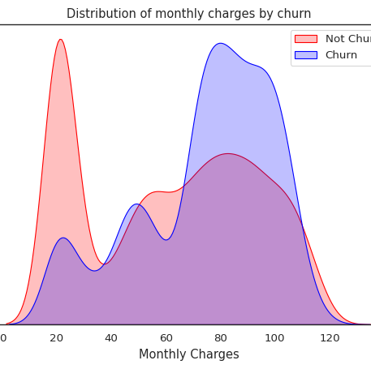
Distribution of monthly charges by churn
Customers with higher monthly charges are more likely to churn

Slide 19
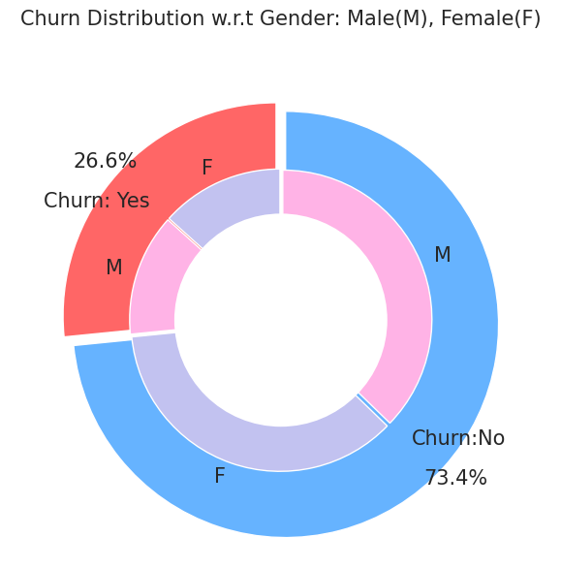
Churn Distribution by gender

Slide 20
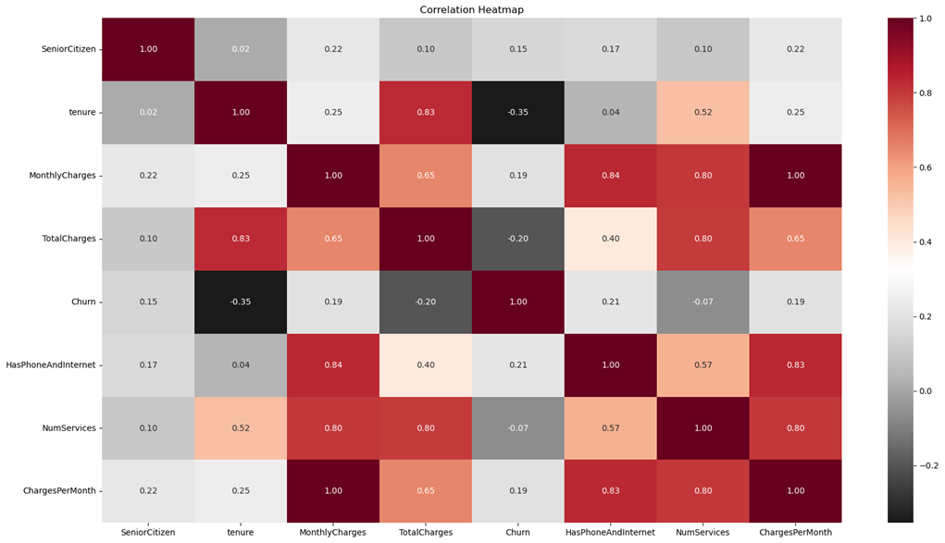
Checking for correlations and plotting a correlation heatmap
A moderate negative correlation exists between churn and tenure, suggesting that customers with longer tenure are less likely to churn.

Slide 21
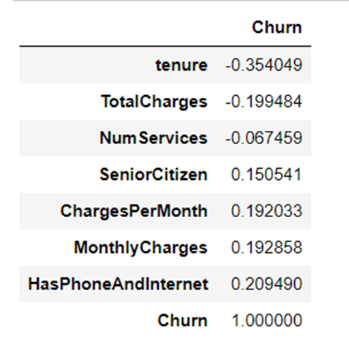
the correlation values between the features and the target churn
Tenure (-0.35): longer-term customers are less likely to churn.
Total charges (-0.20): higher total spend lowers churn risk.
Has phone and internet (0.21) and monthly charges (0.19): higher churn risk for customers with bundled services or higher bills.
Senior citizen (0.15): slightly higher churn among senior Citizens

Slide 22
Data preprocesing
Missing values : checked for missing values and found a small percentage so it was removed (total charges) column
Data encoding :encode categorical variables like binary variables using label encoder , multi-class variables using one-hot encoding
Type conversion : converted some columns into the correct type (numeric) to use it easily
Imbalance data : addressed class imbalance using SMOTE and tomek links that helped us achieving high accuracy

Slide 23
Models used and implementation

Slide 24
Used models
Logistic regression : Simple, easy to interpret, and works well for linearly separable data. Useful for understanding the influence of individual features on churn probability
Random forest : Reduces overfitting by combining multiple decision trees and improves accuracy, especially for imbalanced datasets. Works well with both continuous and categorical features.
Decision tree : Captures non-linear relationships and provides easily interpretable rules. Handles categorical data naturally

Slide 25
Accuracy comparison
Random forest 86.202%
Logistic regression 85.305%
Decision Tree 81.076%

Slide 26
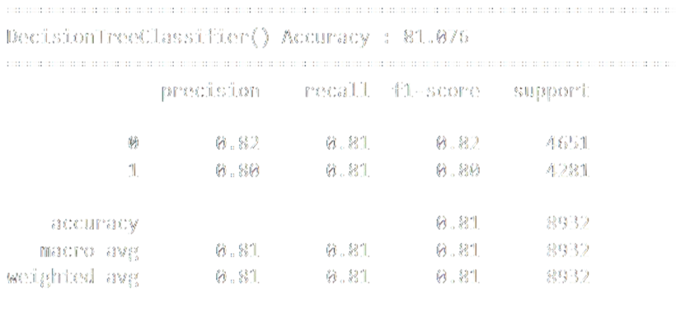
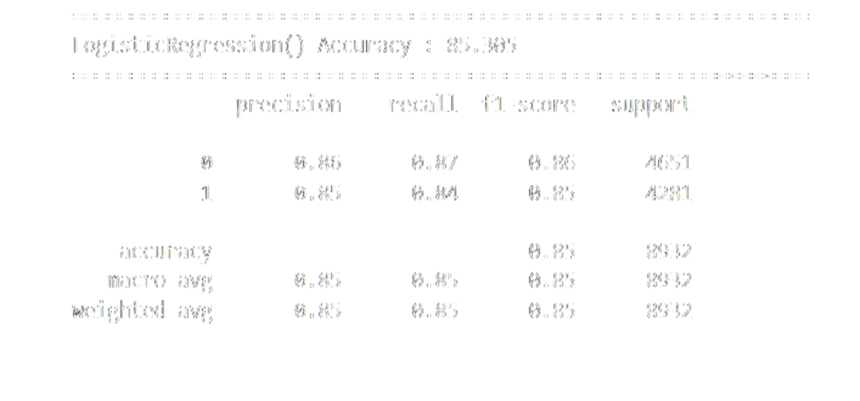
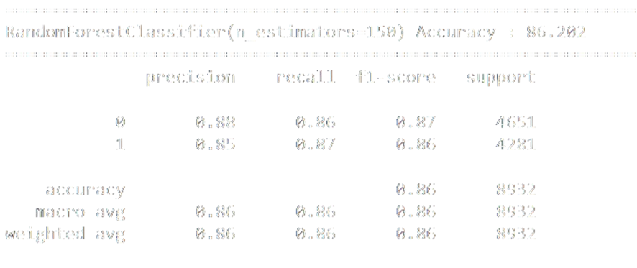
Confusion matrix report

Slide 27
Best model performance
While all three models performed well, the Random Forest model showed slightly superior accuracy and ROC AUC scores with cross-validation approach. This suggests that it may be the preferred model for predicting customer churn in this dataset

Slide 28
Thank you

